Slide 1
Flight price CASE STUDY
By poonam kocheta

Slide 2
Feature description

Slide 3

Data visualization

Slide 4
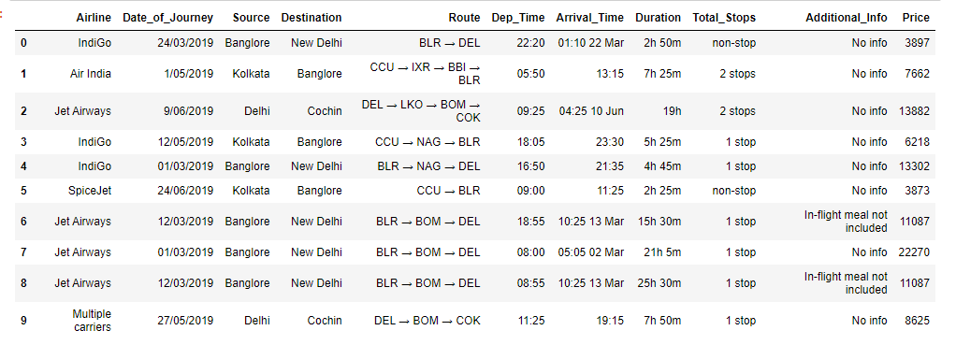

Slide 5
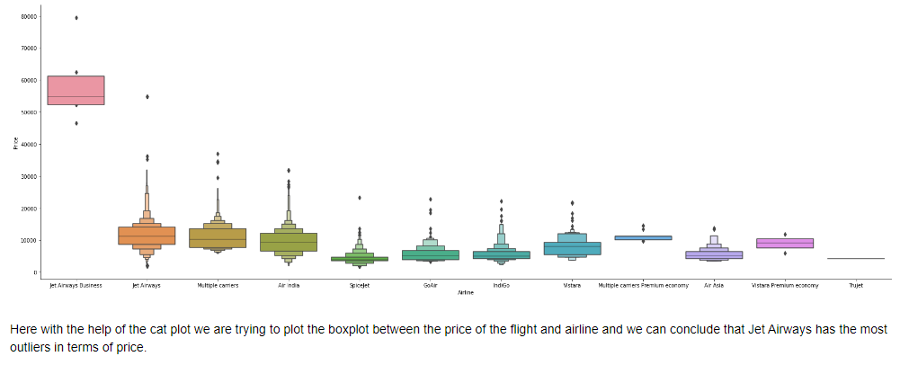

Slide 6
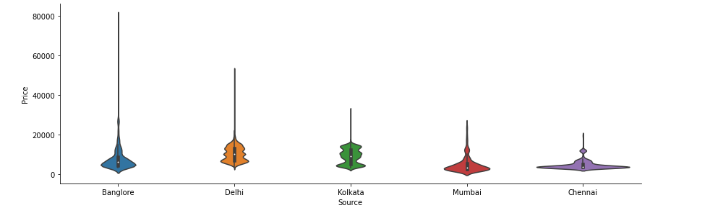

Slide 7
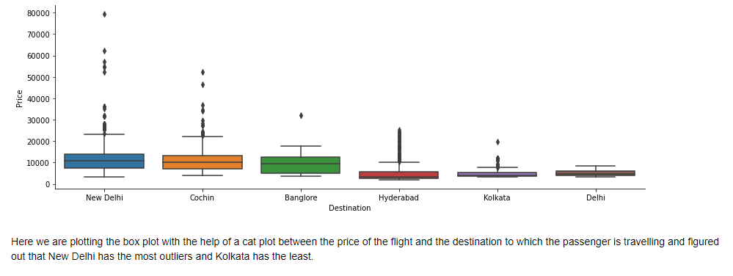

Slide 8
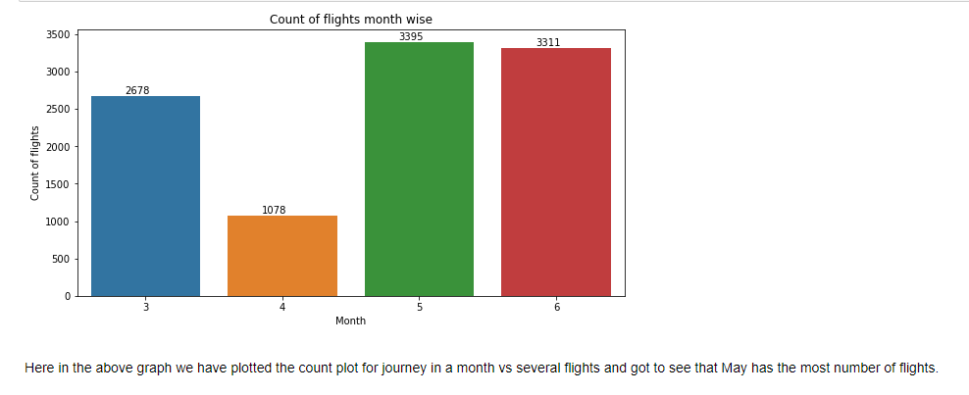

Slide 9
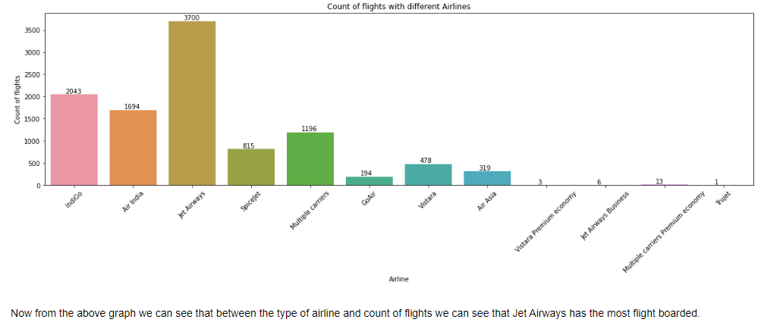

Slide 10
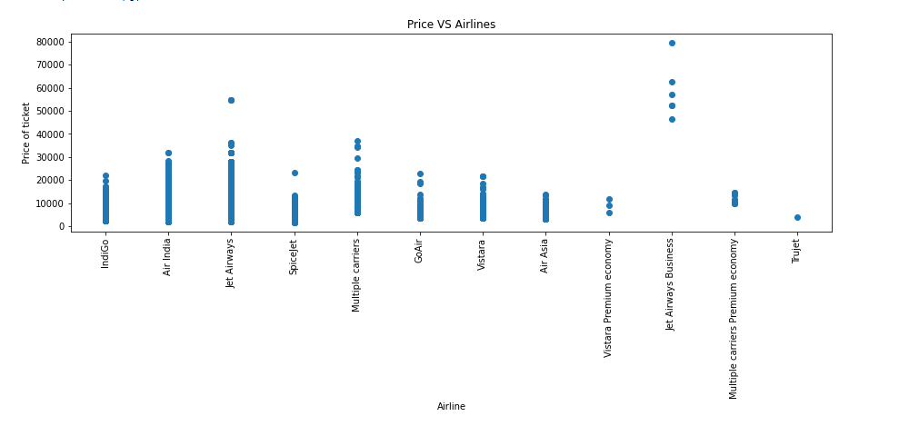

Slide 11
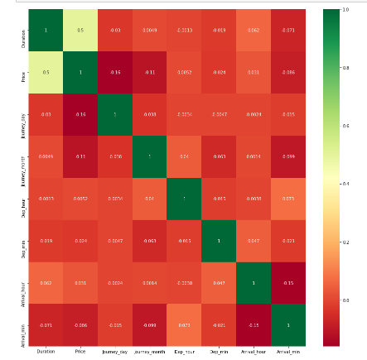

Slide 12
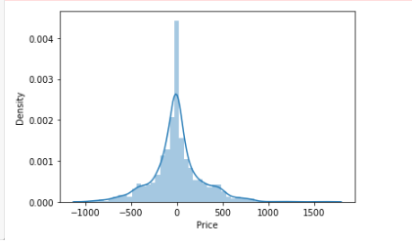

Slide 13
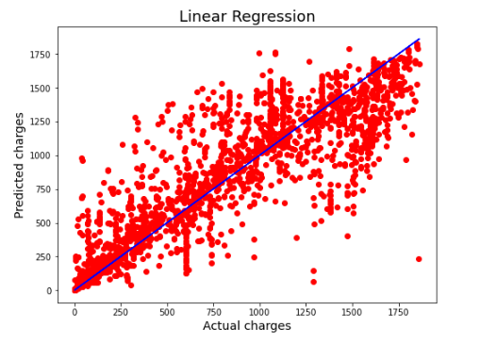

Slide 14
After training or testing the model with different Classifier the Highest accuracy is given by Random Forest Classifier That is 77%. And we do Cross validation, the Model gives 78% score for cross validation.

Slide 15
Thank you

